Slide 1

TRUST Access Pre-requisite
TRUST Developer Team
Koay Choon Wee
Cheah, Hui Ling
Tang, Shiew Cheong
Yew, Chuu Tian

Slide 2
Important: You need to have all the following EAM and AGS access approved in order to use TRUST.
Compulsory group membership to use TRUST:
1271_MAOCCData (EAM)
1272_MAOCCData (EAM)
1273_MAOCCData (EAM)
TMGUSER_DIE300CC (EAM)
TMGUSER_MAOATM (AGS)

Slide 3
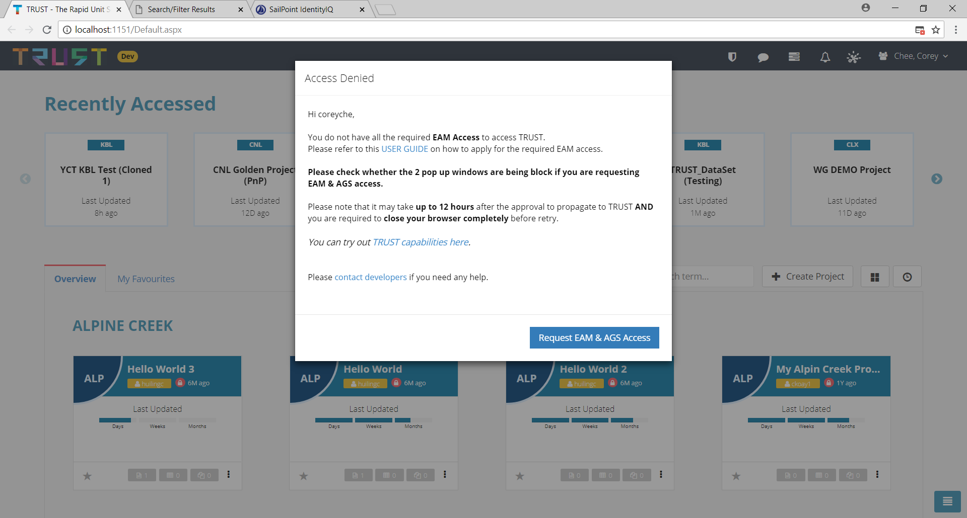
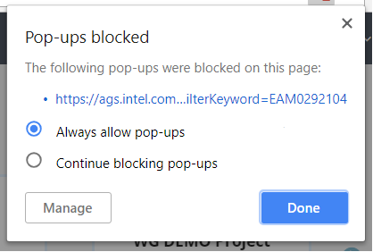
Accessing required EAM and AGS access through TRUST Webpage
2
3
Make sure that there are 2 pop up window within the browser or there might be windows that are being blocked
If user experienced blocked pop-up, user can click on this button and set to “Always allow pop-ups” and click on the “Request EAM & AGS Access” button again
1
For user that does not have all the EAM and AGS access, a modal window will pop up in TRUST webpage in which user can click on the “Request EAM & AGS Access” to get directed the page to apply the required access

Slide 4
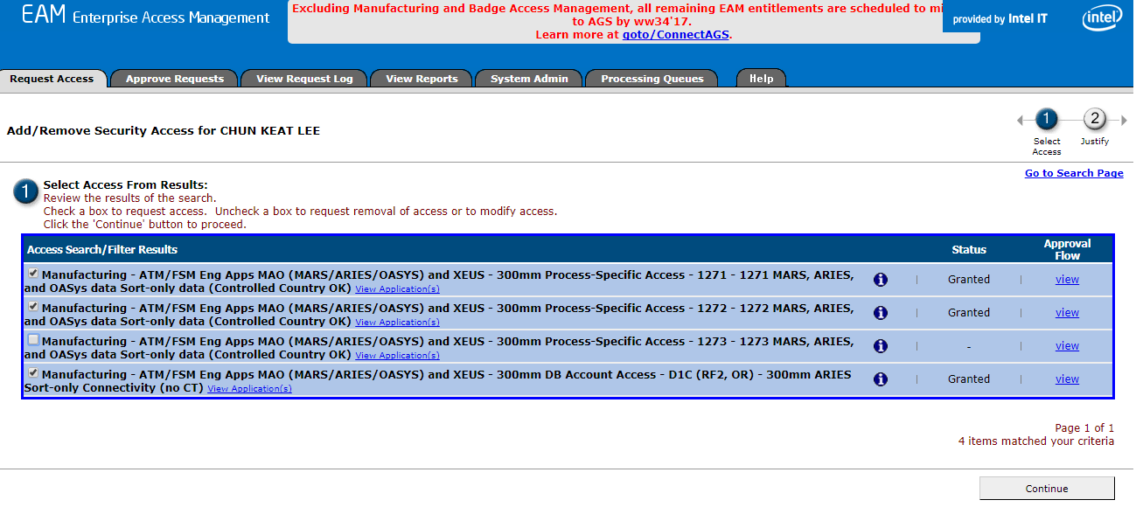
Apply for Missing EAM Access
Go to the link below and apply for all EAM Access that have not been granted as displayed in the page. (EAM recommended browser of choice is IE)
https://eam.intel.com/EAMWeb/RequestAccess/Paging.aspx?Administration=FALSE&Others=FALSE&OtherUsersSelected=&ID=260790,453832,564286,292112,668845
1
Make sure all the items are Granted
Select all the checkbox
2
3
Click “Continue” to proceed

Slide 5
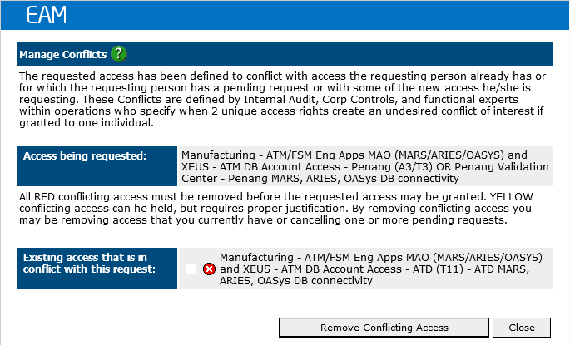
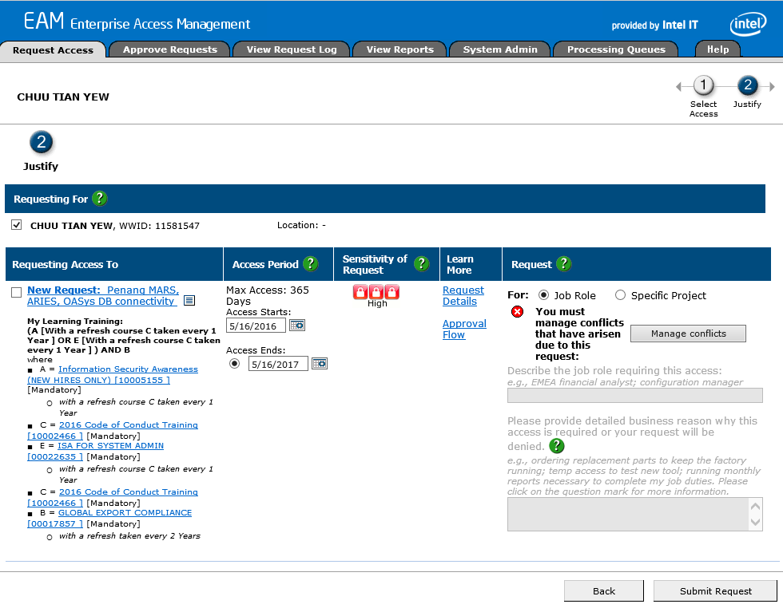
Managing Conflicts
Click “Manage Conflicts”
You can skip the application for this conflicted access (ATM DB Account Access) as any one of the site will be sufficient to access TRUST:
ATD (T11)
Chengdu (A7/T7, China)
Costa Rica (A6/T6)
Kulim (Malaysia)
Penang (A3/T3) OR Penang Validation Center
Vietnam (A9/T9)

Slide 6
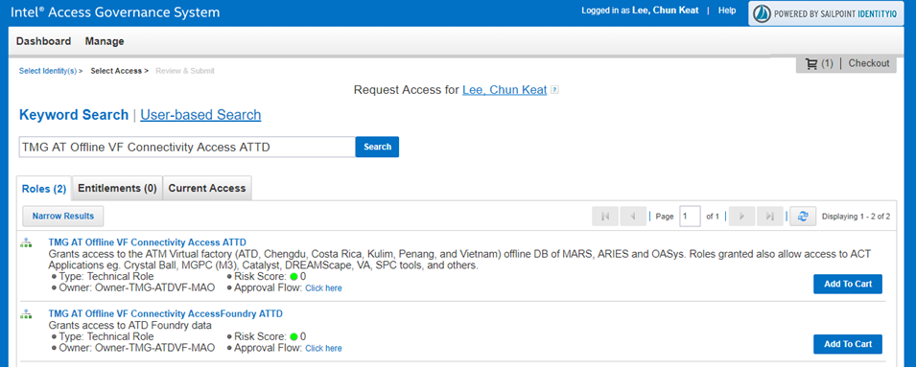
Apply for AGS Access
Go to the link below to apply for AGS access https://ags.intel.com/identityiq/ui/rest/redirect?rp1=/accessRequest/accessRequest.jsf&rp2=accessRequest/manageAccess/add?filterKeyword=EAM0292104
Keyword: TMG AT Offline VF Connectivity Access ATTD
Key in the keyword
4
Click “Checkout”
1
Click “Search”
2
3
Click “Add to Cart”

Slide 7
FAQs
Q: Do I need all the access in the list when I work on a certain process only (e.g P1273)?
A: Yes. All access must be granted first because users can access all the data in the list (P1271, P1272 and P1273) through TRUST .
Q: I’m already working with TRUST. Can you please provide me access automatically?
A: No. All TRUST users will need to go through the proper application procedure.
Q: I am a contingent worker and I cannot seem to apply for the access mentioned in the list. What should I do?
A: Unfortunately, TRUST access will therefore be halted because according to Intel’s policy, contingent workers are not allowed EAM access for SORT and CLASS data.

